Slide 1
Movie RecommendATION
Name: HEENA
Class: BTECH AIML
Year: 2026
ERP: 250414

Slide 2
Movie Recommender System

Slide 3
Introduction
What is Recommender/ Recommendation System?
Let’s clarify this concept by a simple example, suppose you go clothing shop to buy the “Jeans”, then the shopkeeper shows us multiple types, colors, and materials jeans from his shop collections. Then we pick up the one jeans similar to our need and ask the shopkeeper that leads us similar to this pattern, material jeans and then shopkeeper shows us or recommended us the particular type of jeans as per our need this is a recommendation system
Recommender systems are the way of suggesting or similar items and ideas to a user’s specific way of thinking
A Recommender system is a data science problem to predict what the users or customers want based on the historical data. Learning recommendation system could be better with python package to accompany our studies

Slide 4
Scope of Project
For the past year we are in our house due to a pandemic so most of our time we will spend watching mobile or watching movies and series with family or alone. But at that time it’s hard for us to select which movie we should watch because we have so many options but we are confused about what movie is similar to the content of the other movies or if you like one movie and you would like to similar genera movie how we find? So,there my website will guide you, you just have to select a movie that you watch and then the website automatically recommended you a similar type of movie using the Machine learning model. It will ease our needs and reduce the effort of finding a movies
The movie recommender system uses the movie dataset and with the help of Machine learning model to process the data and handle that data using the concept of data science, we create a website where you should select the movie and similar to that movie we give a proper recommendation
A Recommender System refers to a system that is capable of predicting the future preference of a set of items for a user and recommending the top items. One key reason why we need a recommender system in modern society is that people have too many options to use due to the prevalence of the Internet.

Slide 5
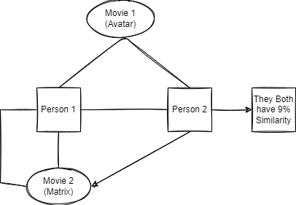
Types Of RecommendATION System
Content Based
It will Recommend ate on the bases of content similarity, In this system we used tags for recommendation
Collaborative filtering
It will recommend ate on users interests, lets clear the concept with one example there is 2 person they both have similarity like 9% they both like Avatar movie and there rating for this movie is same then if suppose person 1 watch matrix movie and he like that movie then collaborative filtrating recommend ate person2 a similar movie
Hybrid
It is mixture of both content based and collaborative filtering recommendation system
“In This Project we use content based recommendation system using and add tags to our movie data set”

Slide 6
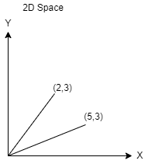
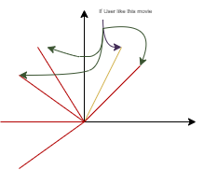
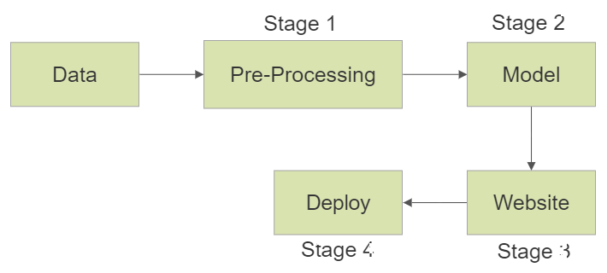
CORE idea
We have data in way like “movie id”, “names” and “tags” like this format we have 5000 movie.
now to use this data set in proper form we try to convert tags in vector form.
suppose user like 2,3 movie then my recommendation system will show them closet vector or similar tags movies
To converting text into vector the method know as “textvectorization” to do textvectorization we have many format
Bag of word
tf idf
word to vector
For this model we use bag of word method to convert text Into vector

Slide 7
Tools for project
For Movie Collection we use “TMDB 5000 Movie Dataset” for processing ML model
We use python language for this project
Jupiter notebook(IDE) for creating the ML model
Pycharm (IDE) for creating a frontend or web app for the movie recommender system
And for this project we use a new framework known as “Streamlit” it helps us create a web app for data science and machine learning in a short time
Heroku(website) for web services and project deployment and hosting the project free of cost

Slide 8
Thank You

